Slide 1
Comparative Analysis of Human Stress Prediction Using Multi-Models Natural Language Processing System
Presented By-
19201084 Mohammad Nasif Sadique Khan
19101623 A S M Nasim Khan
19201076 MD. Adnan Howlader
20101127 Farah Binta Haque
20101549 Md Fardin Rahman Ami

Slide 2
Introduction
Stress in Digital Era: Exploration of stress dynamics in the context of modern digital communication platforms.
Dataset Insight: Utilization of the "Dreaddit" dataset collected from Reddit, a rich source of diverse user-generated content.
Predictive Model Evaluation: Systematic assessment of machine learning and deep learning models for stress identification.

Slide 3
Introduction (Contd.)
F1-Scores Emphasis: Beyond accuracy, focus on F1-Scores to balance precision and recall in emotionally charged content classification.
Comprehensive Model Set: Evaluation of traditional classifiers, ensemble methods, and cutting-edge neural networks.
Support and Intervention: Research-driven aim to contribute tools supporting individuals struggling with stress-related issues.

Slide 4
Literature Review
For identifying signs of mental disorders, deep learning methods have done better than classical AI.
But, there are still difficulties to be resolved.
By facilitating early detection and personalised interventions, NLP has the potential to revolutionise psychological care.
NLP models can be used to identify people at risk of mental disorders.
NLP can be used to analyze data to prevent suicide
Text classification tasks can be automated using transfer learning models.

Slide 5
Literature Review (Contd.)
Future study should focus on multiclass categorization, emoticons, and larger datasets.
Dreaddit dataset is larger than existing stress analysis datasets
It offers a more comprehensive understanding of stress symptoms.
It used to train supervised models such as NB, LR, CNN, SVM, DT.
It offers insightful analysis of how stress is expressed on social media.

Slide 6
Data Collection
Dreaddit: A Reddit Dataset.
Social media data used to identify stress in Reddit communities.
190K posts from five categories.
Used to create models of psychological stress
Reference: Turcan, E., & McKeown, K. (2019). Dreaddit: A Reddit dataset for stress analysis in social media. arXiv preprint arXiv:1911.00133

Slide 7
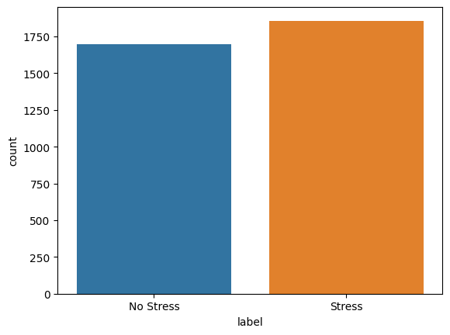
Data Description
1) Initial feature size 116.
2) Label is 0 for “No stress” or 1 for “Stress”
3) 3553 unique rows containing different posts from Reddit

Slide 8
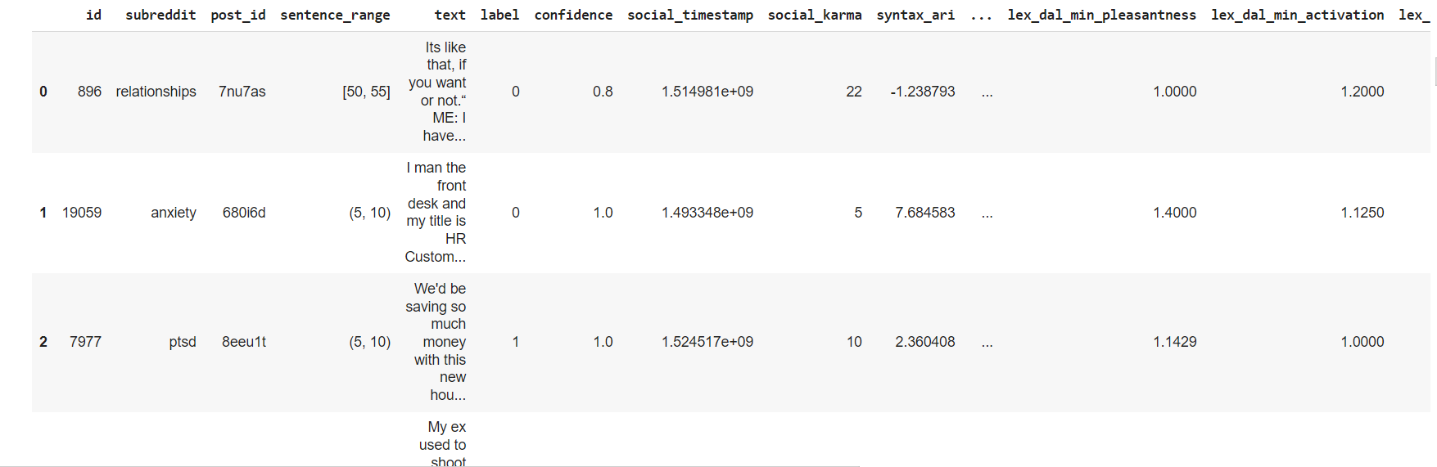

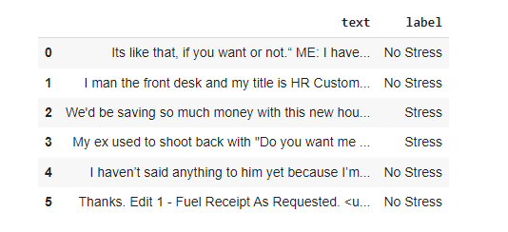
Data Sample
Fig: Dreaddit dataset - before preprocessing

Slide 9
Pre Processing Steps
Removing special characters and punctuation:
[?!$%#&:</>]
Removing stopwords:
[am, is, the, was]
Lemmatization and stemming:
[going->go, cats-> cat]

Slide 10
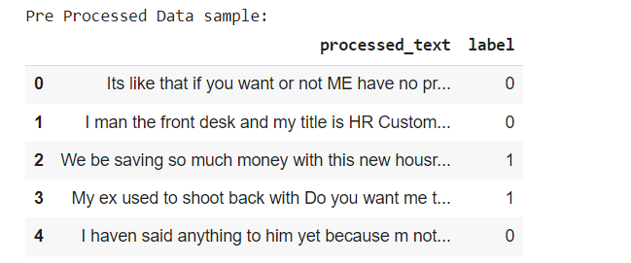
Pre-Processed Data Sample
Fig: Dreaddit dataset - after preprocessing

Slide 11
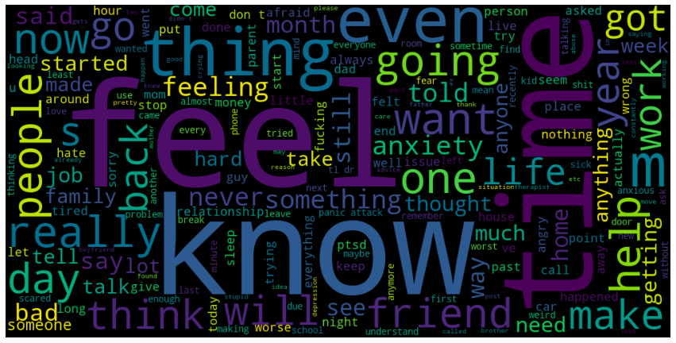
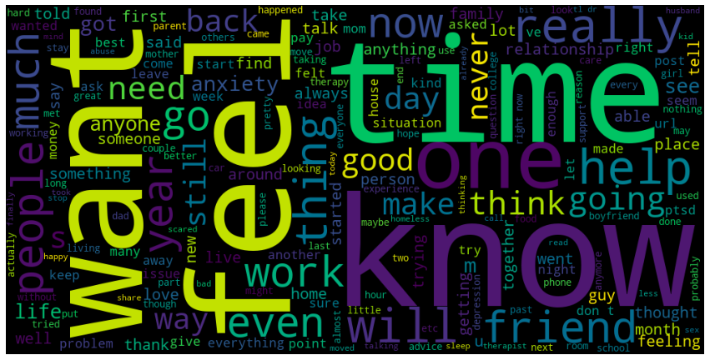
Data Analysis
Fig: Words Cloud of Stress Words
Fig: Words Cloud of Not Stress Words

Slide 12
Used Models (Non-Neural Models)
Multinomial Naive Bayes (MNB)
Support Vector Classifier (SVC)
K-Nearest Neighbors (KNN)
Random Forest
Decision Tree
Multi-Layer Perceptron (MLP)
Logistic Regression
AdaBoost
XGBoost

Slide 13
Used Models
(Neural/Attention Based Models)
Attention-LSTM
Recurrent Neural Network - LSTM (RNN-LSTM)
Convolutional Neural Network - LSTM (CNN-LSTM)
Bidirectional Encoder Representations from Transformers (BERT)
Distilled Bidirectional Encoder Representations from Transformers (Distil-BERT)

Slide 14
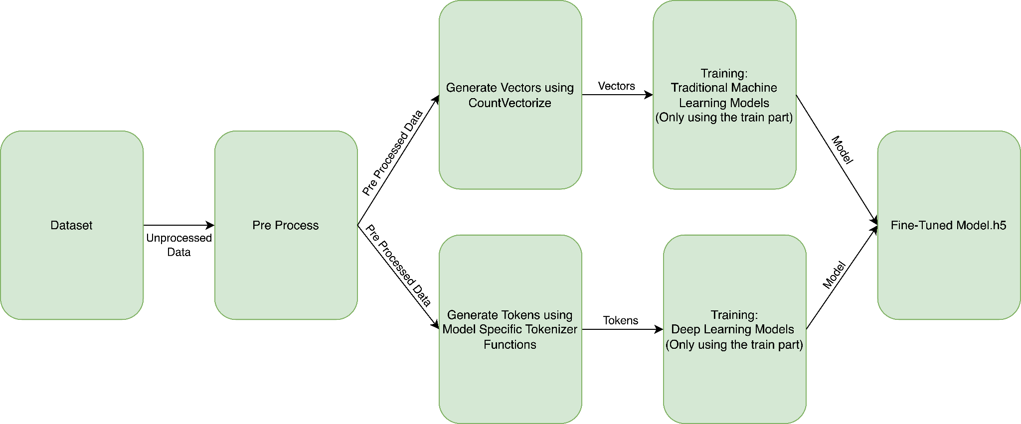
Training Phase

Slide 15
Methodology
The study compares conventional and deep learning methods for classifying texts as stressful or not stressful.
After preprocessing steps CountVectorizer was used to generate vectors
For classifying texts as stressful or not stressful, deep learning models perform better.
SVMs, KNN, Bayes, Random Forest, Decision Tree, Perceptron, and Adaboost were used to analyze data.
In order to explore stress prediction and find patterns, non-neural models were applied.

Slide 16
Methodology (Contd.)
The accuracy of stress prediction can be improved by neural models incorporating attentional mechanisms.
Neural models with attention processes are constructed on the foundation of non-neural models.
Neural models, particularly those with attention mechanisms, RNN-LSTM, CNN-LSTM, have shown a remarkable ability in capturing complex patterns and relationships in intricate datasets.
The training approach for each of these deep learning models consisted of 35 epochs, with a batch size of 45.The development of this strategic approach was influenced by the understanding that LSTM neurons have the ability to comprehend complex contextual details, allowing them to effectively distinguish between important and unimportant phrases.

Slide 17
Methodology (Contd.)
BERT and DistilBERT’s Methodological Similarity: Both BERT and DistilBERT models share comparable methodologies compared to their predecessors. However, their input text encoding processes differ. They utilize default tokenization techniques from libraries like transformers and TensorFlow Hub modules. These techniques involve breaking down input text into smaller units, incorporating special tokens like [CLS] and [SEP], maintaining the models' context-capturing capabilities critical for tasks like sentiment analysis and natural language understanding.
Epochs and Batch Sizes: The BERT model undergoes 70 epochs with its default batch size, while the DistilBERT model uses 20 epochs with a batch size of 8. These configurations enable BERT and DistilBERT to generate intricate contextual representations of sentences and words, leading to improved performance across a diverse array of natural language processing tasks.

Slide 18
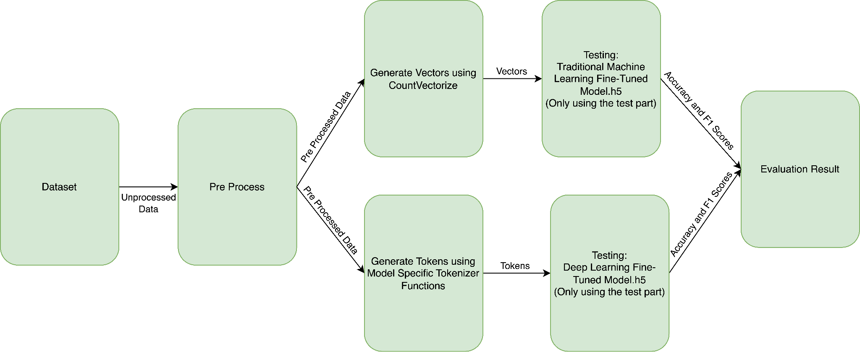
Testing/Evaluation Phase

Slide 19
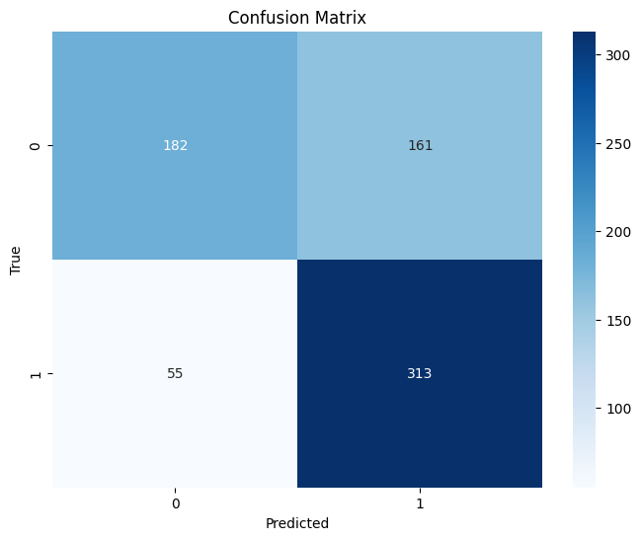
Multinomial Naive Bayes (MNB):
Achieved an accuracy of 69.62%.
Demonstrated an F1-Score of 74.35% for classifying "Stress".
Achieved an F1-Score of 62.76% for classifying "Not-Stress".

Slide 20
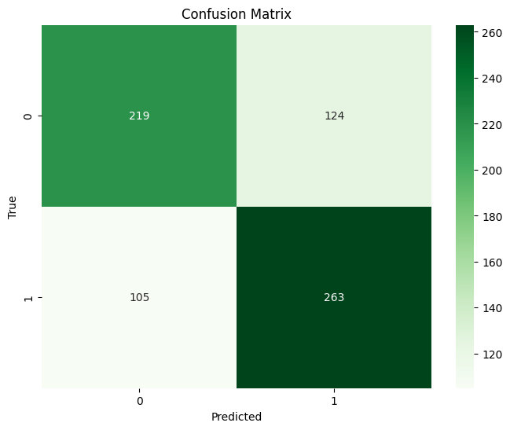
Support Vector Machine Classifier (SVM):
Achieved an accuracy rate of 67.79%.
Attained an F1-Score of 69.67% for identifying instances of "Stress".
Achieved an F1-Score of 65.67% for identifying instances of "Not-Stress".

Slide 21
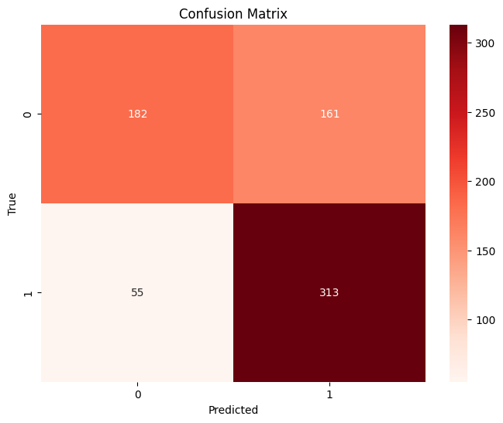
K-Nearest Neighbors (KNN):
Attained an accuracy of 59.07%.
Demonstrated an F1-Score of 56.89% in identifying "Stress" cases.
Achieved an F1-Score of 61.04% in identifying "Not-Stress" cases.

Slide 22
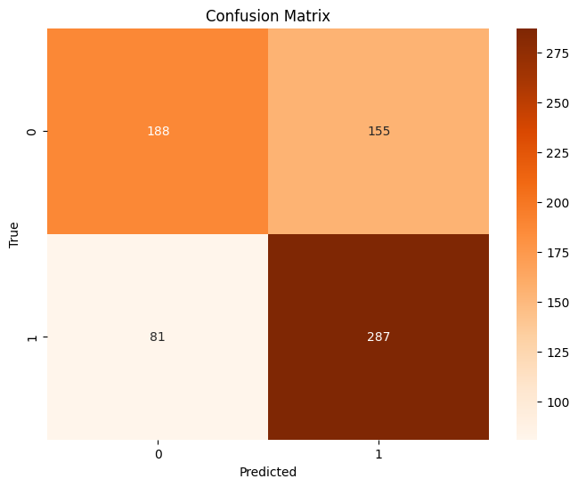
Random Forest:
Accomplished an accuracy of 66.81%.
Achieved an F1-Score of 70.86% for classifying instances of "Stress".
Demonstrated an F1-Score of 61.44% for classifying instances of "Not-Stress".

Slide 23
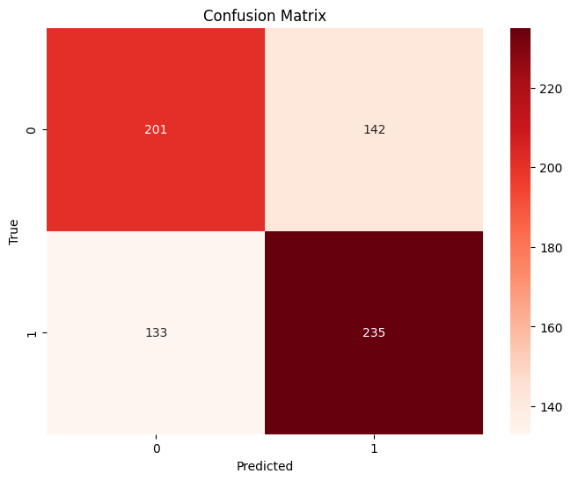
Decision Tree:
Attained an accuracy rate of 61.32%.
Achieved an F1-Score of 63.09% for identifying instances of "Stress".
Demonstrated an F1-Score of 59.38% for identifying instances of "Not-Stress".

Slide 24
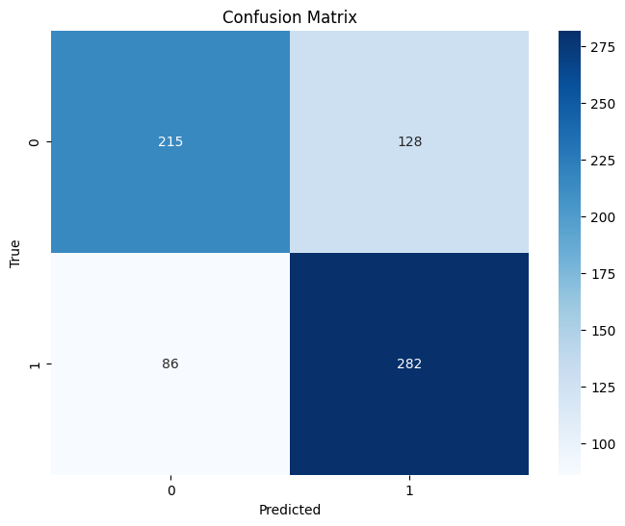
Multi-Layer Perceptron (MLP):
Achieved an accuracy rate of 69.90%.
Demonstrated an F1-Score of 72.49% for identifying cases of "Stress".
Attained an F1-Score of 66.77% for identifying cases of "Not-Stress".

Slide 25
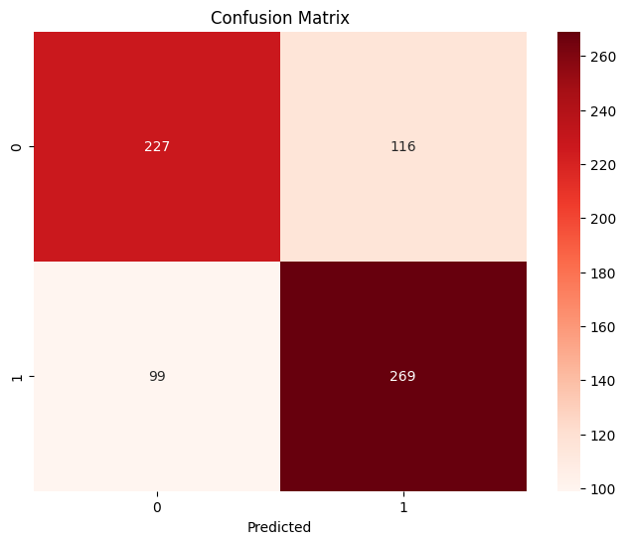
Logistic Regression:
Achieved an accuracy of 69.76%.
Demonstrated an F1-Score of 71.45% for classifying "Stress".
Attained an F1-Score of 67.86% for classifying "Not-Stress".

Slide 26
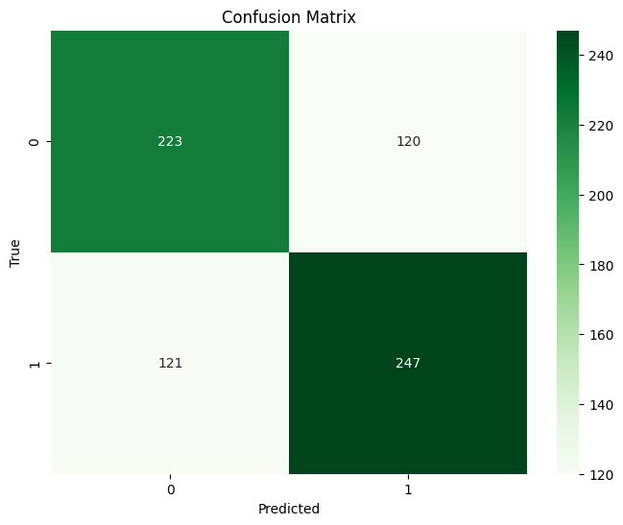
AdaBoost:
Attained an accuracy of 66.10%.
Demonstrated an F1-Score of 67.21% for identifying cases of "Stress".
Achieved an F1-Score of 64.92% for identifying cases of "Not-Stress".

Slide 27
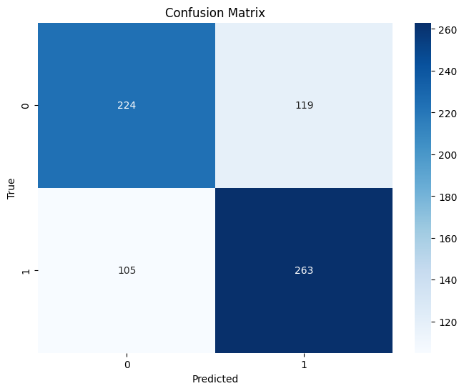
XGBoost:
Attained an accuracy of 66.10%.
Demonstrated an F1-Score of 67.21% for identifying cases of "Stress".
Achieved an F1-Score of 64.92% for identifying cases of "Not-Stress".

Slide 28
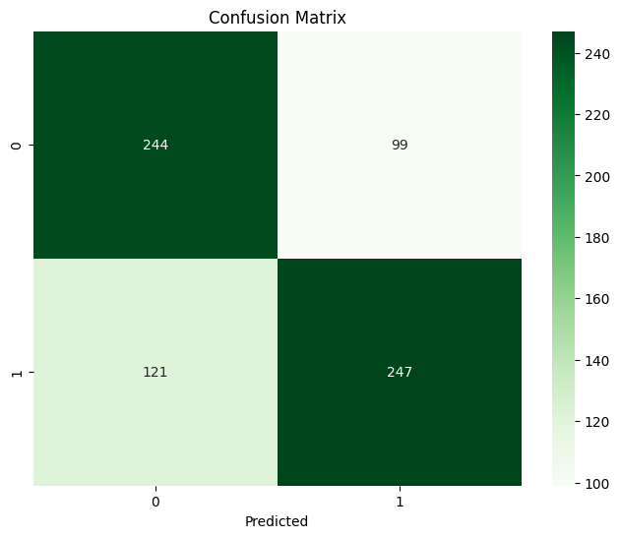
Attention-LSTM:
Attained an accuracy of 69.06%.
Achieved an F1-Score of 69.19% for identifying cases of "Stress".
Demonstrated an F1-Score of 68.93% for identifying cases of "Not-Stress".

Slide 29
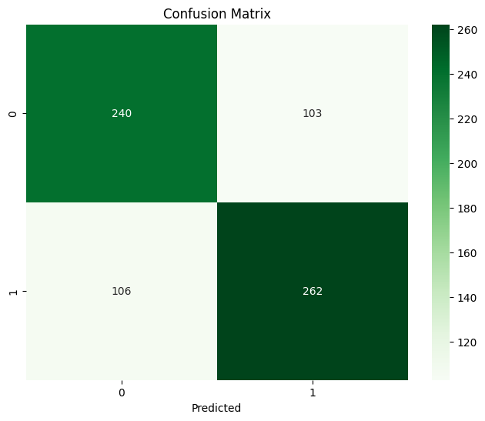
Recurrent Neural Network -
LSTM (RNN-LSTM):
Achieved an accuracy rate of 70.60%.
Demonstrated an F1-Score of 71.49% for identifying instances of "Stress".
Attained an F1-Score of 69.67% for identifying instances of "Not-Stress".

Slide 30
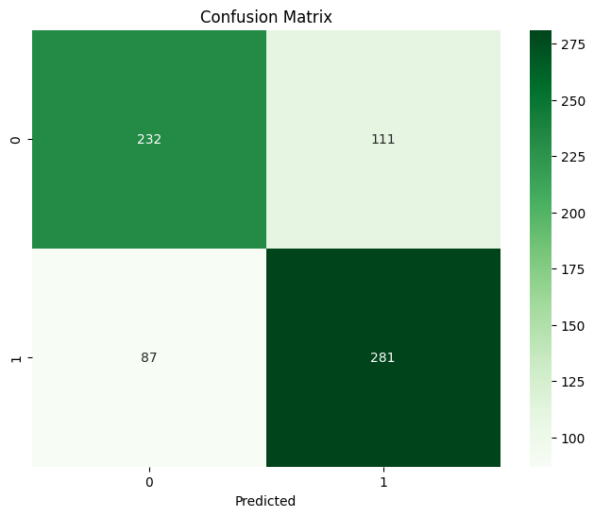
Convolutional Neural Network -
LSTM (CNN-LSTM):
Accomplished an accuracy of 72.15%.
Demonstrated an F1-Score of 73.95% for classifying "Stress".
Achieved an F1-Score of 70.09% for classifying "Not-Stress".

Slide 31
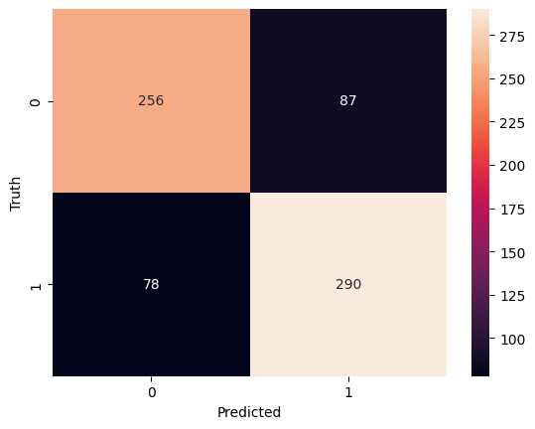
Bidirectional Encoder Representations
from Transformers (BERT):
Achieved the highest accuracy at 76.79%.
Demonstrated an outstanding F1-Score of 78.00% for identifying cases of "Stress".
Attained an F1-Score of 76.00% for identifying cases of "Not-Stress".

Slide 32
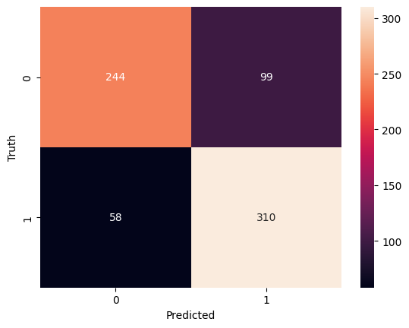
Distilled Bidirectional Encoder Representations from Transformers (Distil-BERT):
Attained an accuracy of 77.91%.
Demonstrated an exceptional F1-Score of 80.00% for identifying instances of "Stress"
Achieved an F1-Score of 76.00% for identifying instances of "Not-Stress".

Slide 33
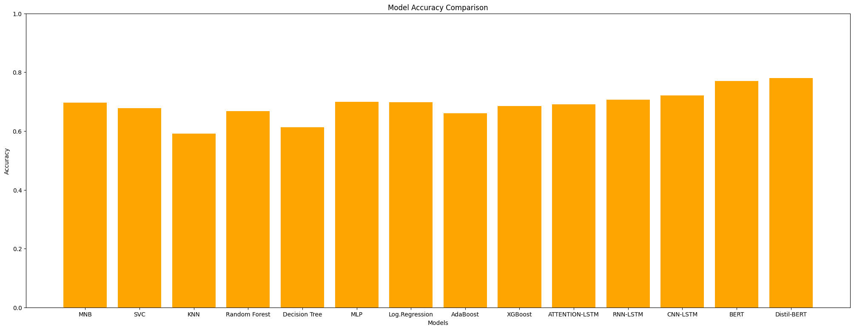
Accuracy Comparison
Attention | Non-Attention
DistilBERT performed best Bert worked second best | MLP worked best Logistic Regression was second
In general, most of the attention based models worked better than General ML models

Slide 34
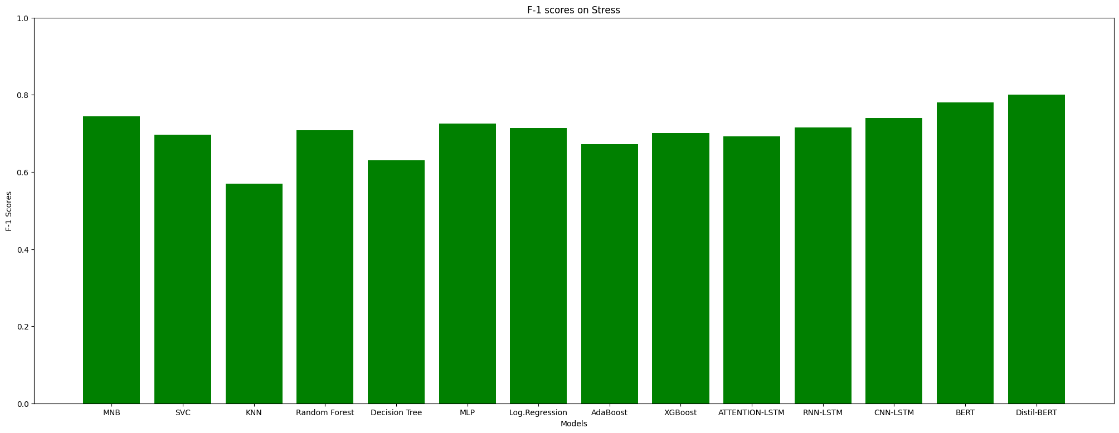
F1- Score Comparison For “Stress”
Attention | Non-Attention
DistilBERT performed best Bert worked second best | MLP worked best Logistic Regression was second
In general, most of the attention based models worked better than General ML models

Slide 35
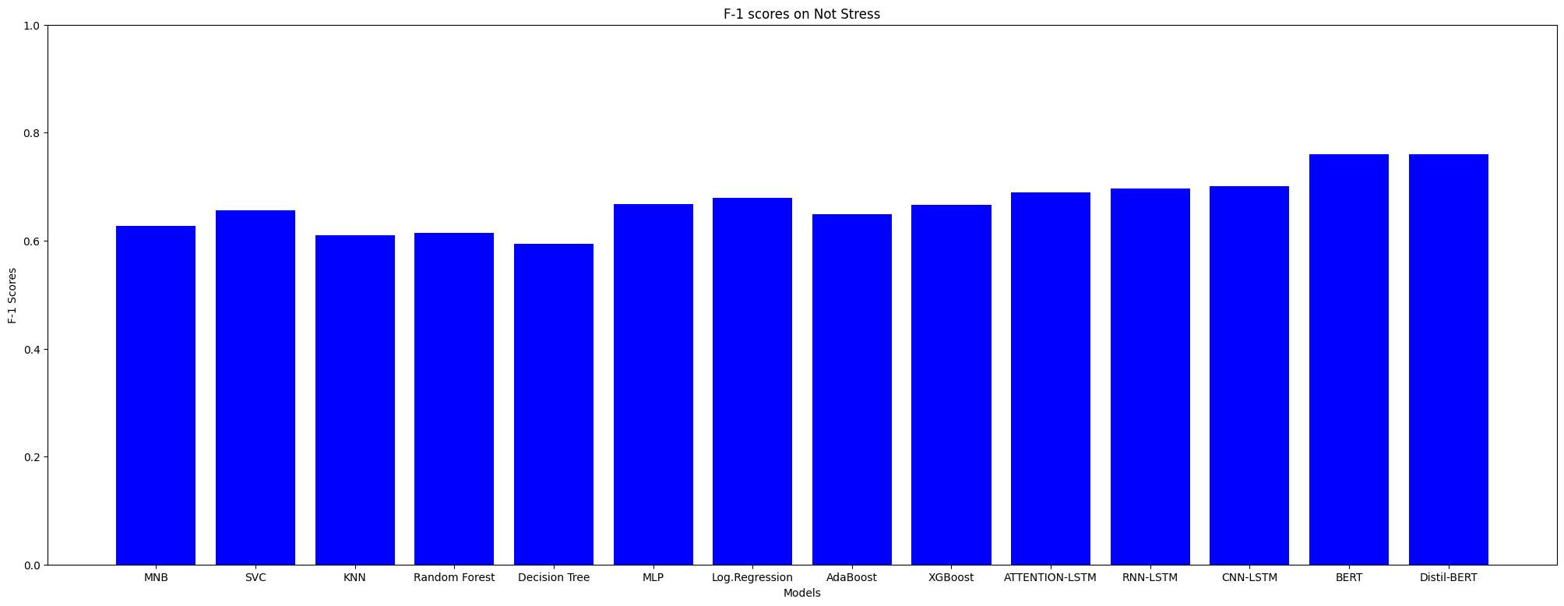
F1- Score Comparison For “No Stress”
Attention | Non-Attention
DistilBERT and Bert performed similarly and they are the best among these models | MLP worked best Logistic Regression was second
In general, most of the attention based models worked better than General ML models

Slide 36
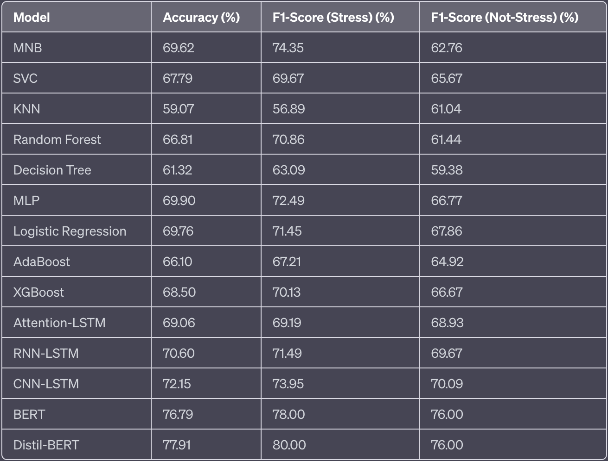
A table comparing the Accuracy and F1-Scores

Slide 37
Future Works and Limitations
Dataset size was not significant. More data available helps models better predict stress.
Other Advanced deep learning models like GPT-4 can be applied
Combining multiple sources of information such as voice data alongside textual data
Scope of working to detect Stress Severity

Slide 38
Conclusion
14 different models have been used.
BERT and Distil-BERT are top performers with achieving accuracy of 76.79% and 77.91% respectively.
The accuracy of the other models ranged from 59.07% to 72.15%.
Deep learning and transformer-based models outperform traditional machine learning models

